Slide 1


Online Learning Management System (LMS)
Title of your Presentation
Team-10:
Dogiparthi Aasrith
Mandava Nidhish
Yarraguntla Kalyan Chakravarthy
Kalla Bharath Vardhan
29-11-2023

Slide 2
Introduction
Project Description:
With the rise of e-learning, there is a need for a comprehensive online platform that can deliver educational content to a wide range of learners. This platform should support various content formats, track learner progress, and provide interactive tools to enhance the learning experience. It must be scalable to accommodate a growing number of users and a broad catalog of courses.

Slide 3
Project Objectives
Develop an intuitive interface for learners and educators.
Support live sessions and on-demand content delivery.
Offer assessment and certification capabilities for courses.

Slide 4
Project Scope
Course Management: Instructors will be able to create, manage, and deliver courses. This includes uploading course materials, conduct quizzes , and grading student work.
Student Management: Students will be able to create accounts, enroll in courses, and access course materials. Students will also be able to take quizzes.
Content Management: The LMS will support a variety of content formats, including text, images, videos, and audio.
Communication and Collaboration: The LMS will include features for communication and collaboration, such as forums, chat rooms.
Assessment and Tracking: The LMS will include tools for assessing student progress and performance. This includes quizzes, and books.

Slide 5
Individual Contributions
Dogiparthi Aasrith: EC2,S3,CloudFront
Mandava Nidhish: Frontend, Lambda, API Gateway, CloudWatch
Yarraguntla Kalyan Chakravarthy: Frontend, API Gateway, Lambda
Kalla Bharath Vardhan: EC2,S3,CloudFront

Slide 6
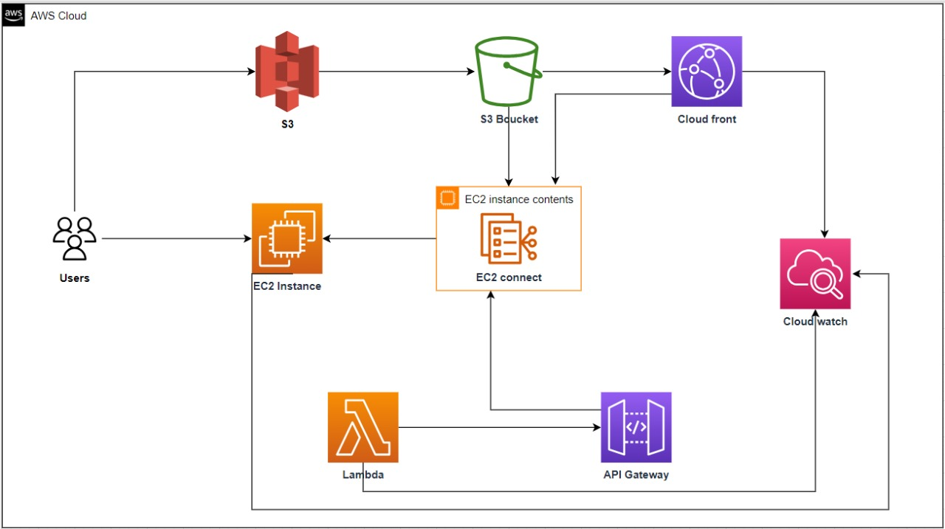
Project Architecture
AWS Services:
Amazon EC2
S3
Lambda
API Gateway
CloudFront
Cloud Watch

Slide 7
Interaction: How these services work together.
As our project needed the multi media content we uploaded the content of the courses like video's and materials in the S3 bucket created. As we need to play the content video's with low latency. So, we added video's from S3 bucket to cloud front. Now we generated the links for the video's from the cloud front and links for the materials from the S3 bucket. The links that we collected from s3 and cloudfront have been attached to the html files so that it can be easily redirected. In our project we need to conduct the skill assessment for our courses so we need backend process to be done. For the backend process we created lambda functions to generate the marks. Once we done with our lambda part we created API gateway and got the API gateway link so that we can connect our frontend and backend part. Once we completed our frontend part(HTML, CSS, JavaScript), we uploaded all the code files in EC2 instance and launched a website. And last but not the least we created cloud watch to monitor the system and provide the analytics.

Slide 8
Key Concepts
Features: EC2 Connect, API Gateways
Services:
Amazon EC2: Host the LMS application.
Amazon S3: Store and distribute multimedia learning content.
AWS Lambda: Automate backend processes.
Amazon CloudFront: Deliver content with low latency.
Amazon CloudWatch: Monitor the system and provide analytics.
API Gateway: For connecting frontend and backend.

Slide 9
Challenges and Solutions
Problem 1: Connecting my html code to the backend lambda function code.
Solution1: Creating the API Gateway and giving the link in the html page.
Problem2: Hosting my web page with EC2
Solution2: In my labs I used to write html code in user data but there are too many pages so we used Ec2 connect to host the website.

Slide 10
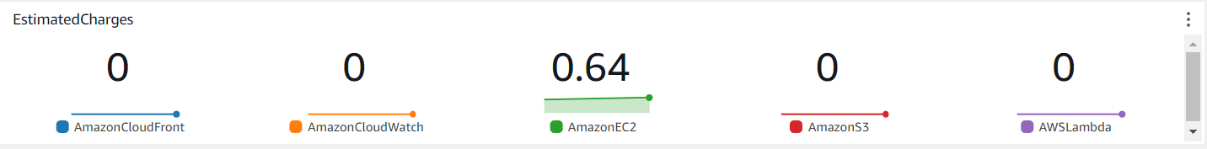
Cost Analysis
Cost Breakdown: Summary of AWS costs.
Total cost for AWS costs is 2.2 dollars.
Budgeting: How costs were managed or optimized.
By stopping the EC2 instance when it is not necessary.
For EC2 used t2.micro (free tier)

Slide 11
Security Measures
Authentication:
Students profile and progress of contents will only available with educators.
Data Protection:
Secure Storage of files in S3
Conduct privacy impact assessments

Slide 12
Lessons Learned
Technical Insights:
Connecting backend and frontend using API Gateway.
For low latency, linking S3 with CloudFront.
Hosting the website using EC2.
Process Insights:
Communication skills
Time Management
Task distribution

Slide 13
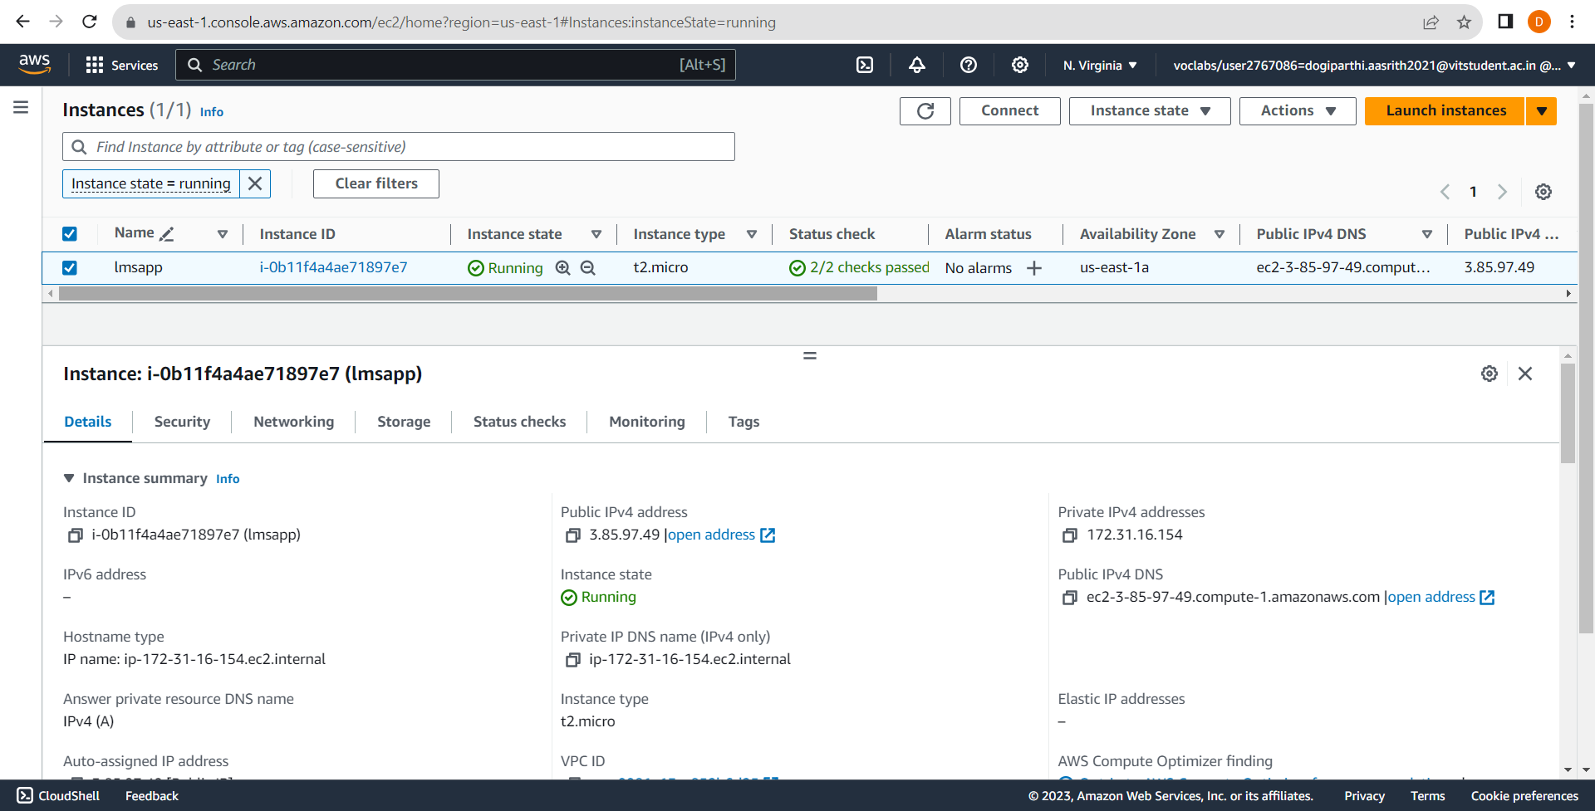
Visual snapshots
EC2
Creating the instance.
By using EC2 connect hosting the website.

Slide 14
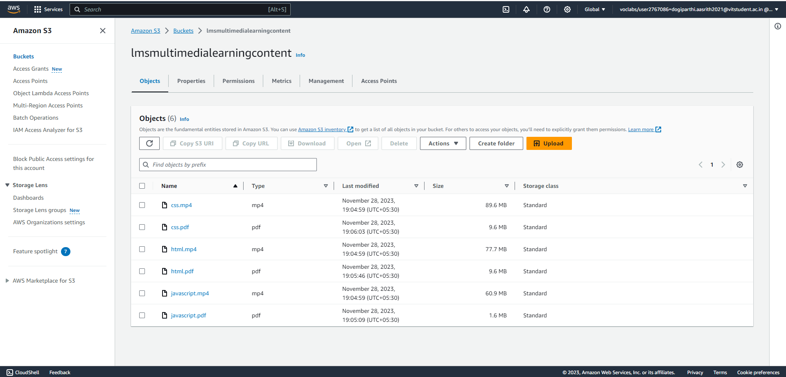
Visual snapshots
S3
Creating the bucket.
uploading the files to the bucket and making it public access.

Slide 15
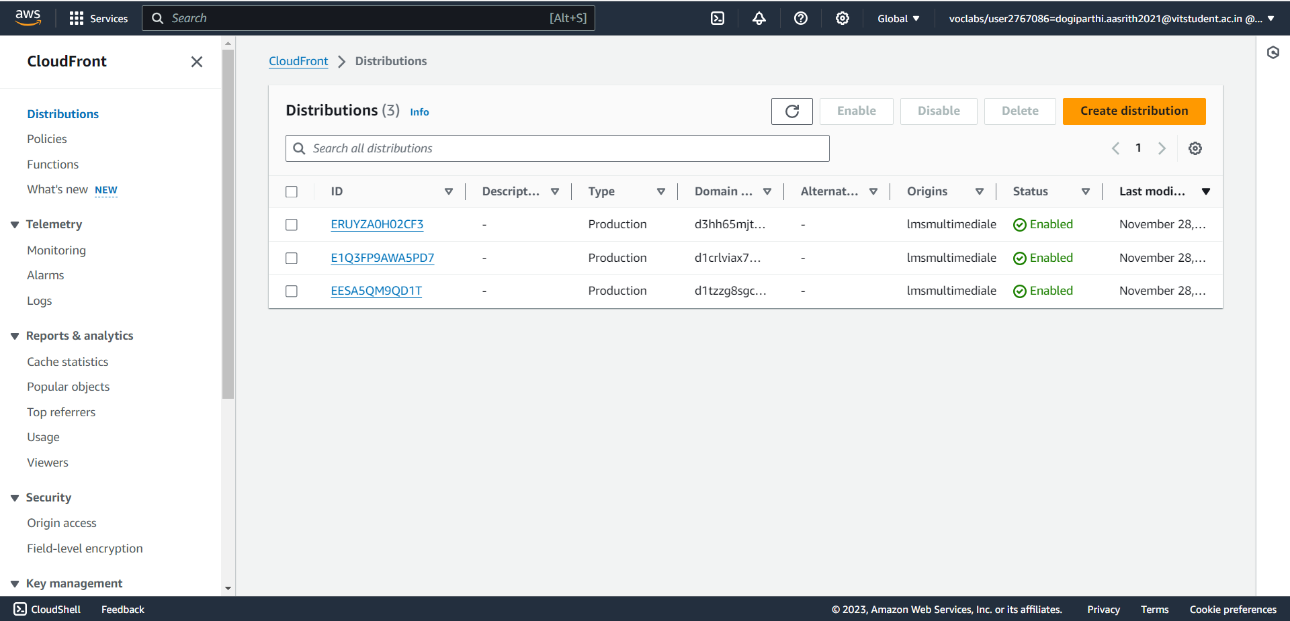
Visual snapshots
CloudFront
Creating the distribution and moving the videos from S3 to cloudfront
For low latency.

Slide 16
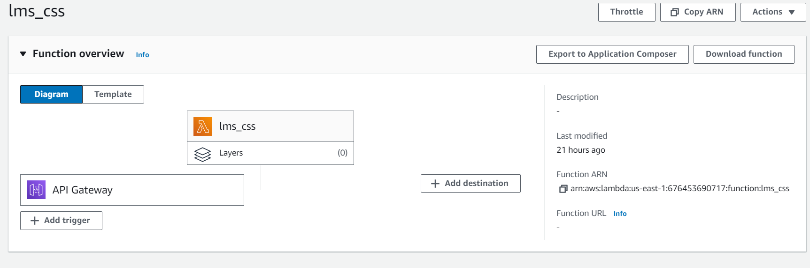
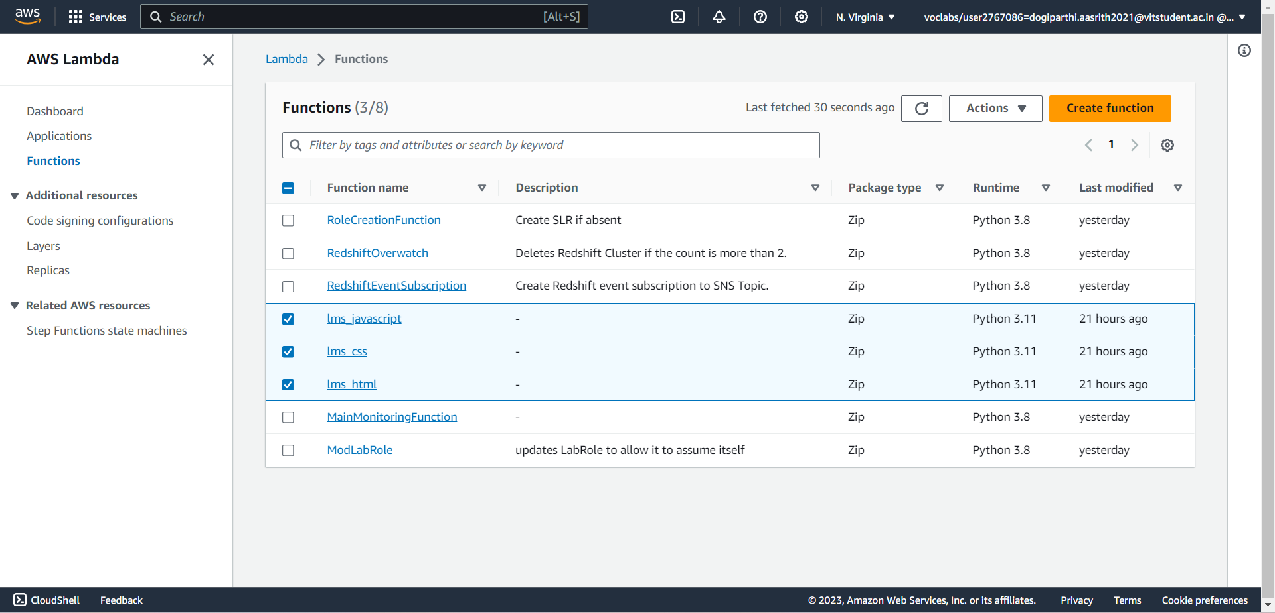
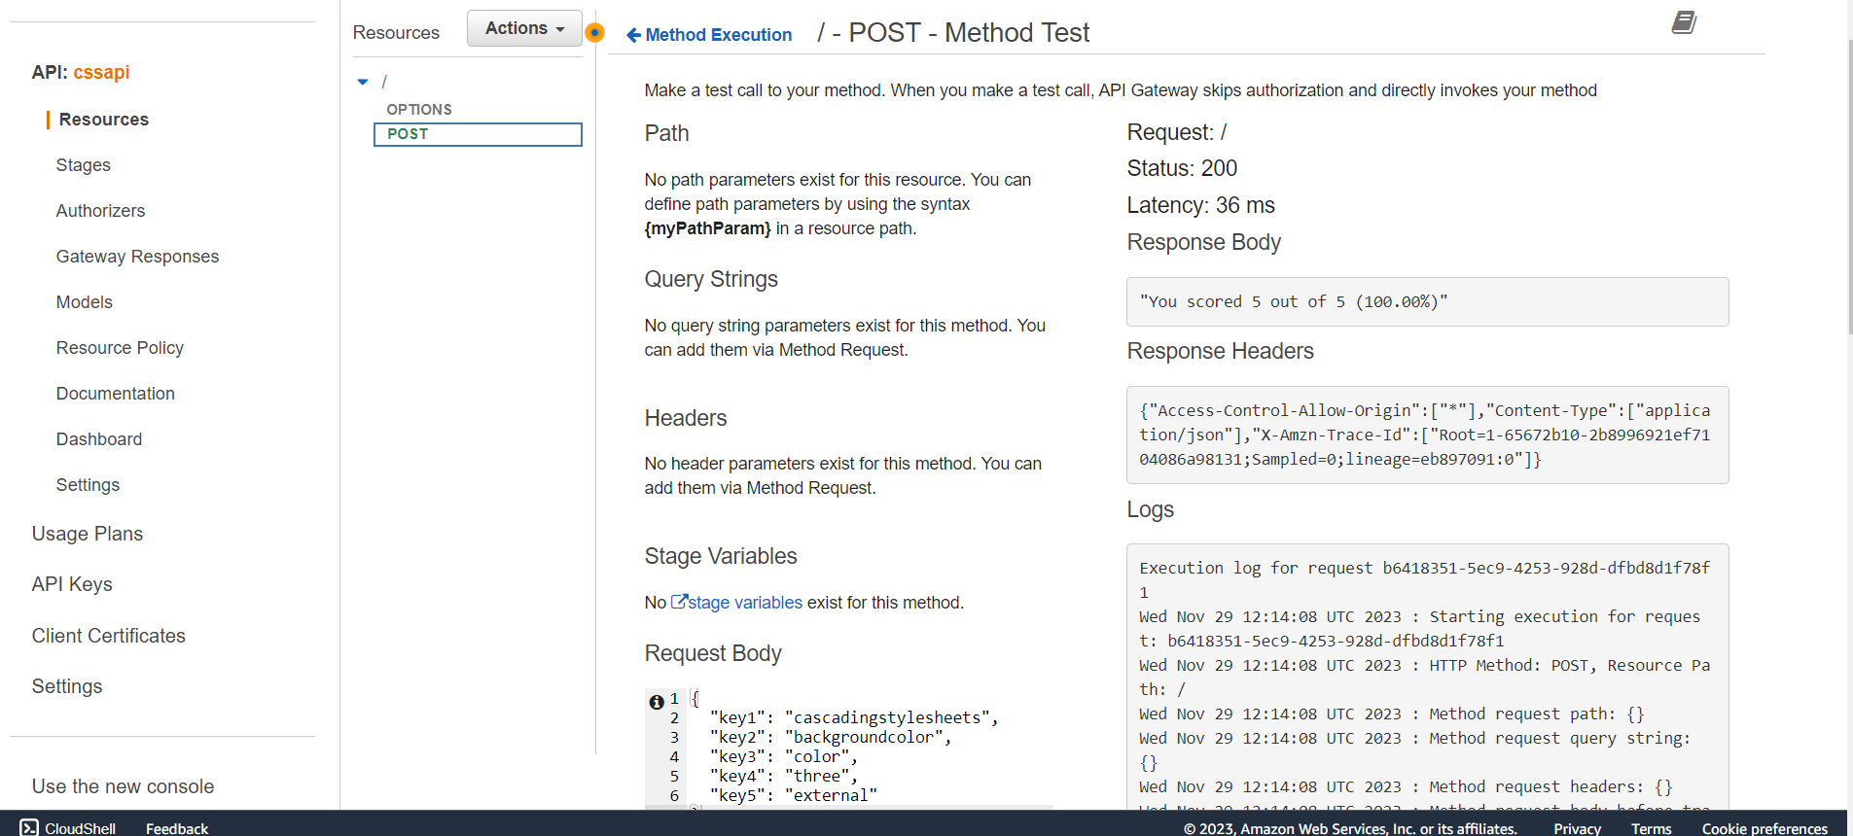
Visual snapshots
Lambda and API Gateway
Creating the three functions for backend process.
Connecting lambda to API Gateway and API Gateway to frontend.

Slide 17
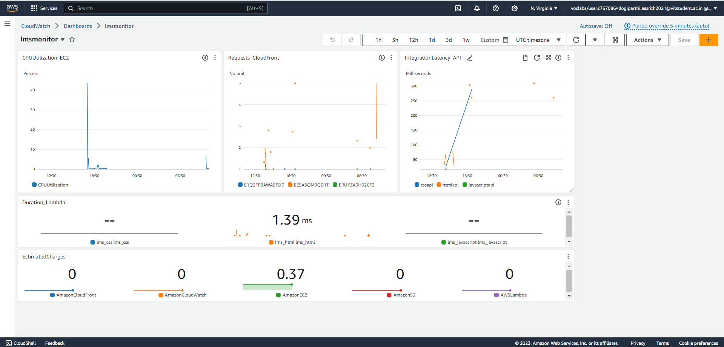
Visual snapshots
CloudWatch
Creating a dashboard for monitoring AWS services

Slide 18
Live Demo
Live Demo
Use case where the project could be applied
Personalized Learning Paths
Real-time Q&A and Tutoring
Interactive Assessments
Course Content

Slide 19
Future Scope
Improvements: Potential updates or add-ons.
The system should be compliant with educational standards and accessibility guidelines.
Must facilitate social learning through forums, chats, and peer reviews.
Provide analytics for educators to track learner engagement and effectiveness of content.
Next Steps: Future phases or expansions
Mobile Learning Optimization
Collaborative Learning Features
Personalized Learning
Support Feature

Slide 20


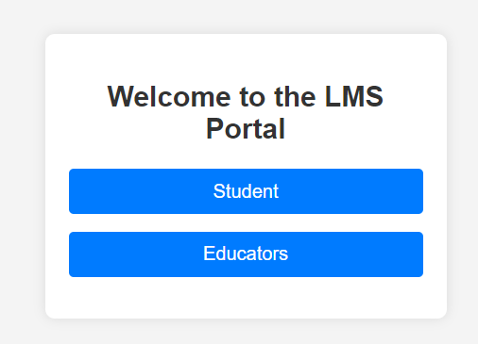
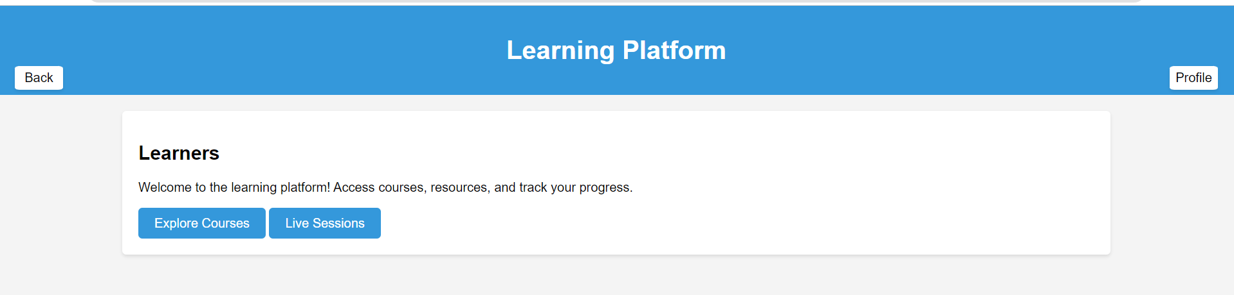
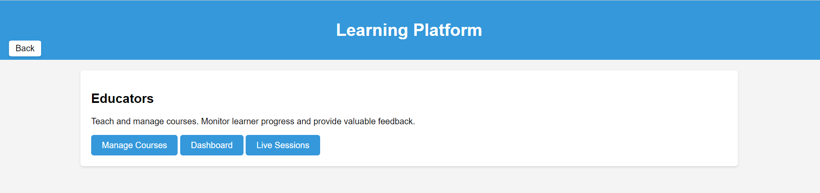
Screenshots
Here goes the subtitle of your section
Project Name 18

Slide 21
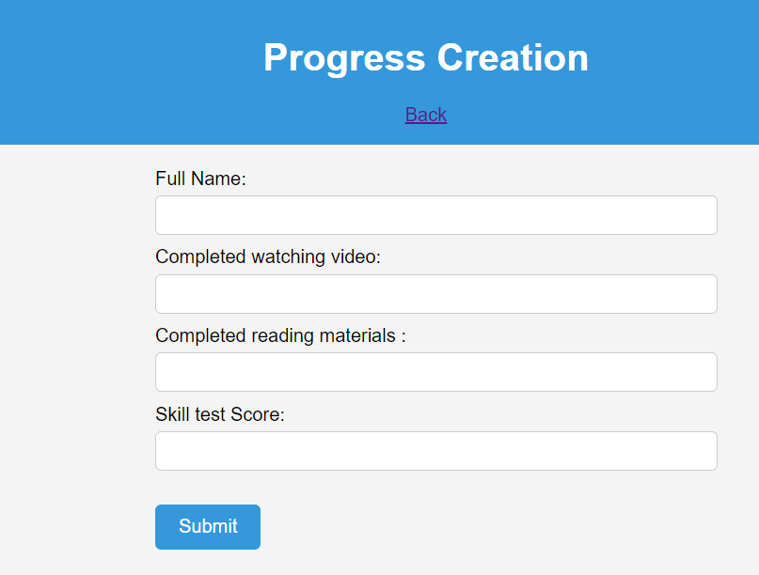
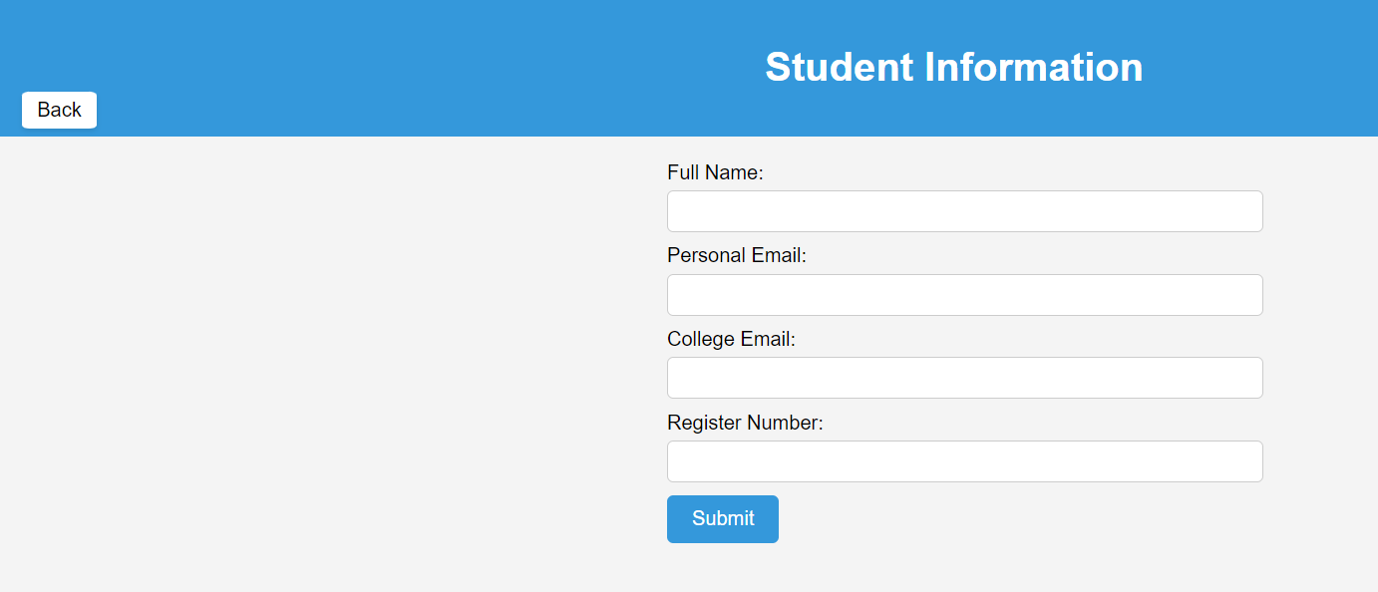
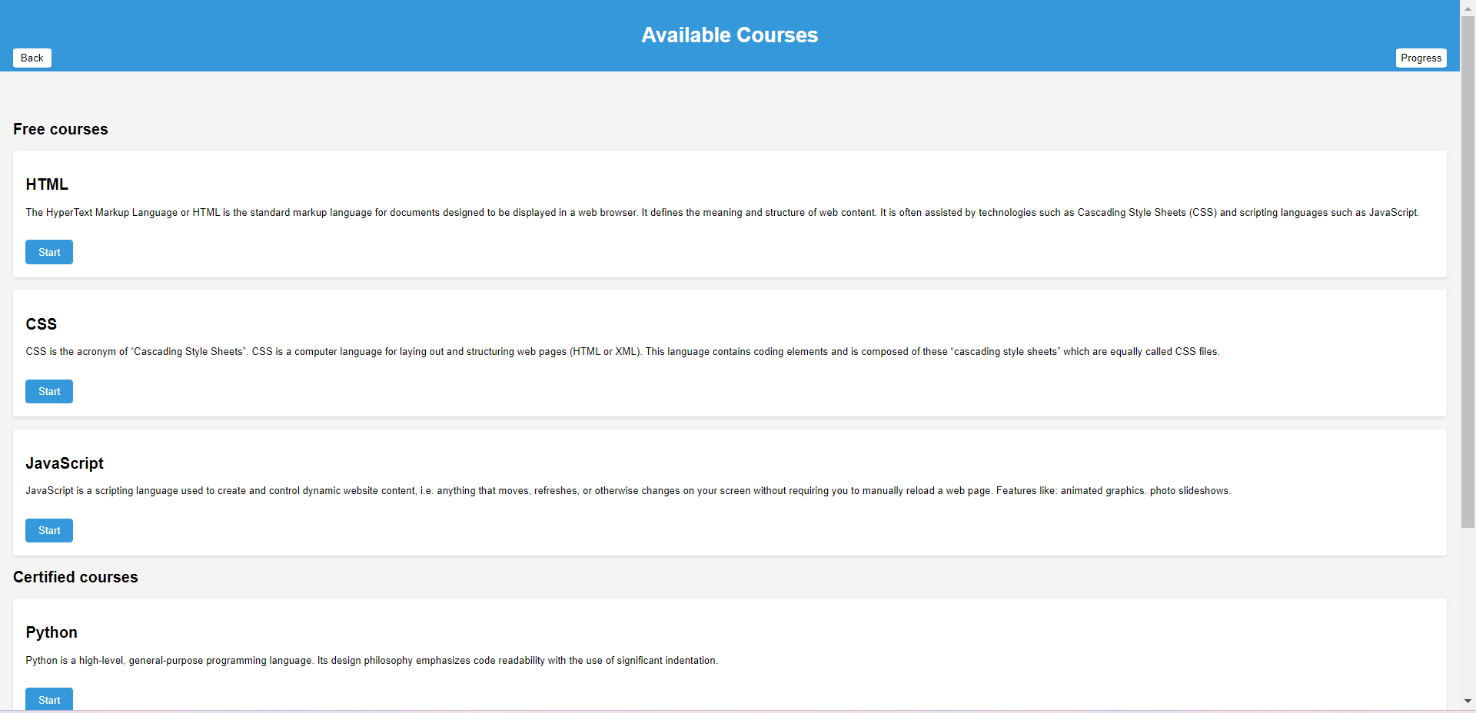
Screenshots
Students Page
19

Slide 22
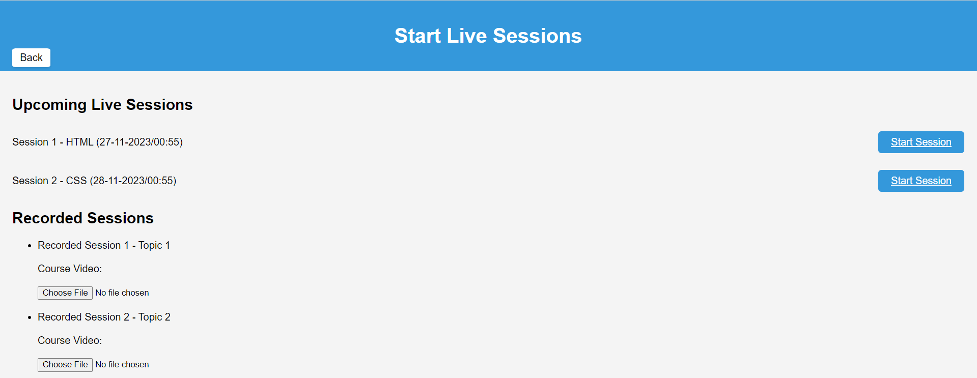
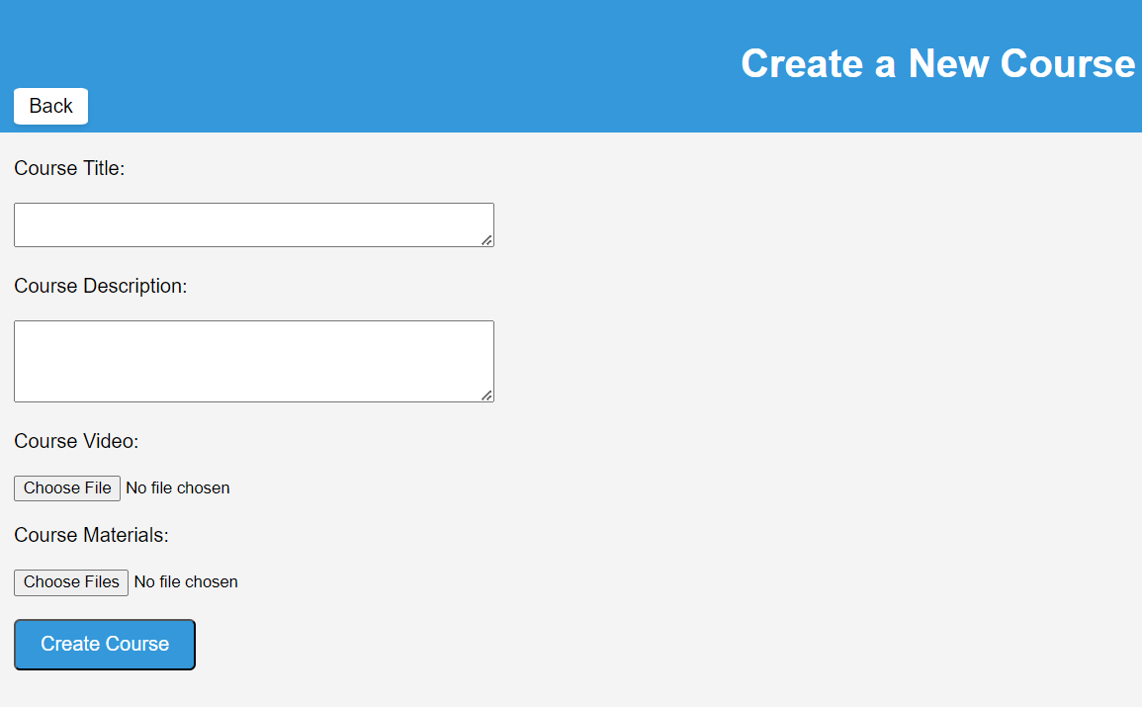
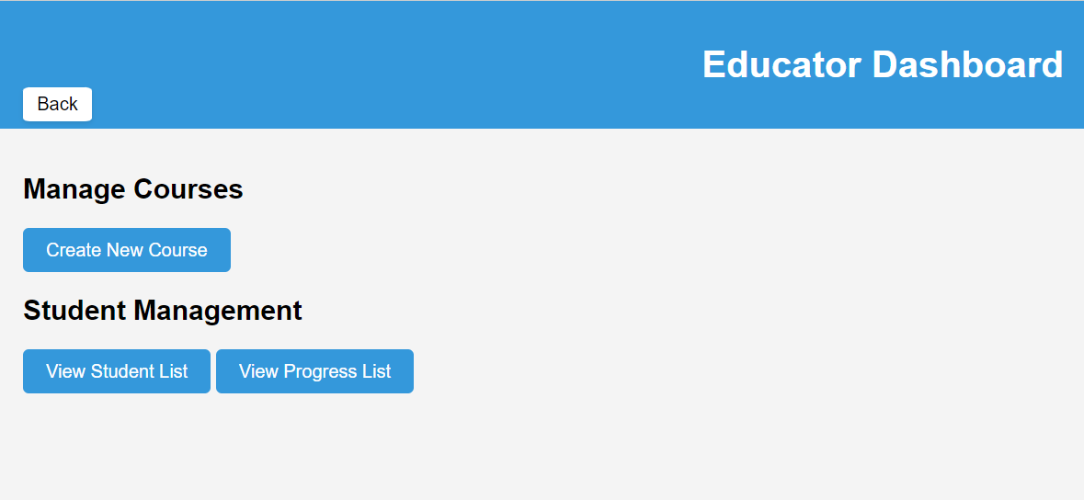
Screenshots
Educators Page

Slide 23
Questions
Questions: Opening the floor for any questions from the audience.

Slide 24


Thank You!!
Thank You!
20
Team-10
Dogiparthi Aasrith
Mandava Nidhish
Yarraguntla Kalyan Chakravarthy
Kalla Bharath Vardhan

